Slide 1
Combinational Circuits Adders and Subtractors
Digital Logic Design

Slide 2
Presentation Outline
Half-Adder
Full-Adder
Half Subtractor
Full Subtractor
Binary Adder/Subtractor
Carry propagation
Iterative Design

Slide 3
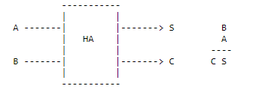

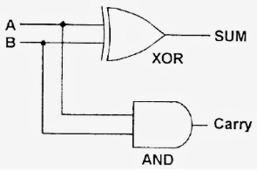
Half Adder
Inputs |  | Outputs
A | B | C | S
0 | 0 | 0 | 0
0 | 1 | 0 | 1
1 | 0 | 0 | 1
1 | 1 | 1 | 0

Slide 4
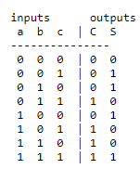
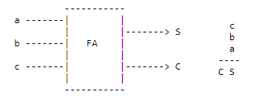


Full Adder

Slide 5

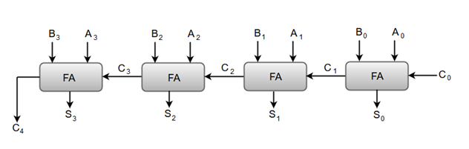
4-bit Full Adder

Slide 6
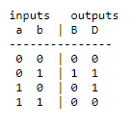
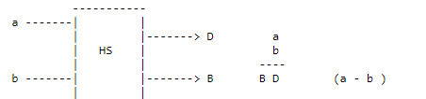

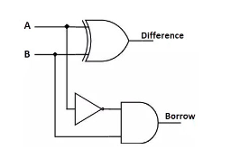
Half Subtractor

Slide 7
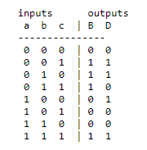
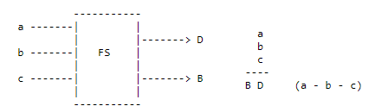

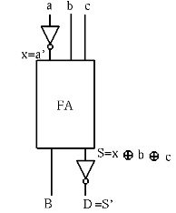
Full Subtractor

Slide 8
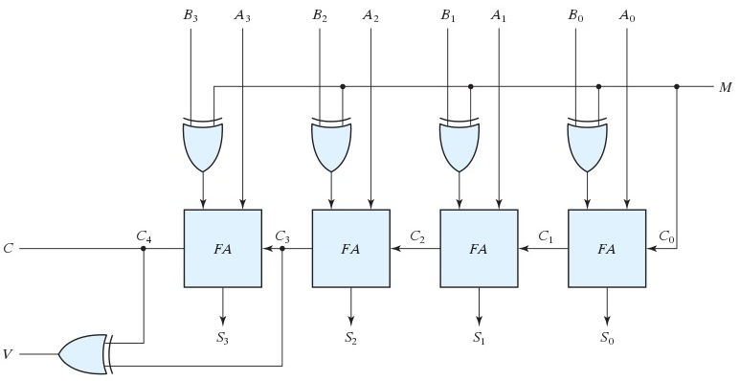
Binary Adder Subtractor

